Slide 1
Introduction to Computer networks
Dr. Shilpi Harnal
Department of Computer Science and Engineering
Chitkara University, Punjab

Slide 2
Introduction to Computer networks
A network is set of devices (nodes) connected by communication links (media).
A node can be a computer, printer, or other device capable of sending and/or receiving data.
Link connecting the devices are often called communication channels.
Most network use distributed processing.

Slide 3
Standard Network Criteria
Performance – depends on number of users, type of medium, HW/SW.
Transmit time + Response time
Reliability – measured by freq of failure, recovery time, catastrophe vulnerability
Security – protection from unauthorized access, viruses/worms

Slide 4
Uses of Computer networks
It allows you to share resources such as printers, scanners, etc.
You can share expensive software and database among network users.
It facilitates communications from one computer to another computer.
It allows the exchange of data and information among users through a network.

Slide 5
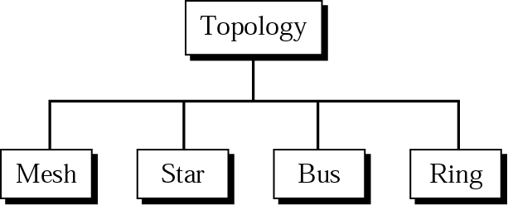
Network hardware
Network Topologies: The way in which a network is laid out physically
4 basic types: Mesh, Star, Bus, Ring

Slide 6
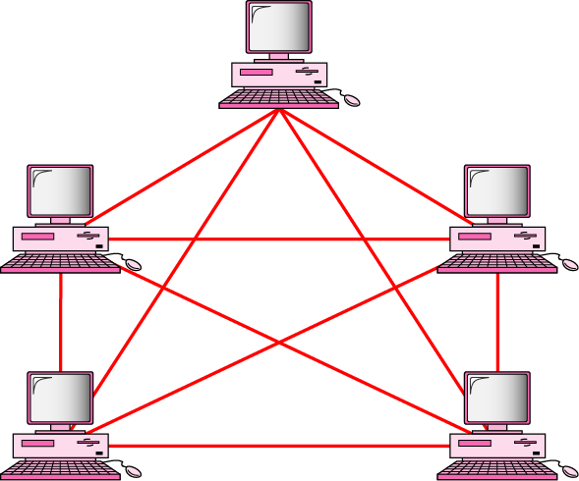
Contd…
Mesh topology: A dedicated point-to-point link connects each device on the network to another device on the network, only carrying data between two devices.
Each node is connected to : n(n-1)/2 nodes

Slide 7
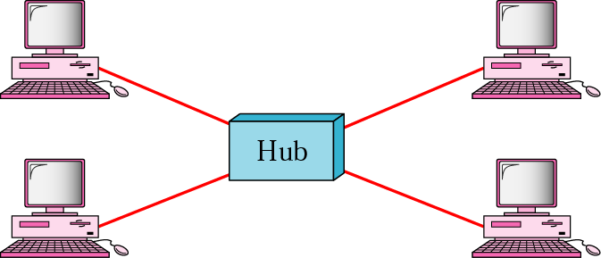
Contd…
Star topology: The most common network topology, star topology connects each device in the network to a central hub. Devices can only communicate with each other indirectly through the central hub.

Slide 8
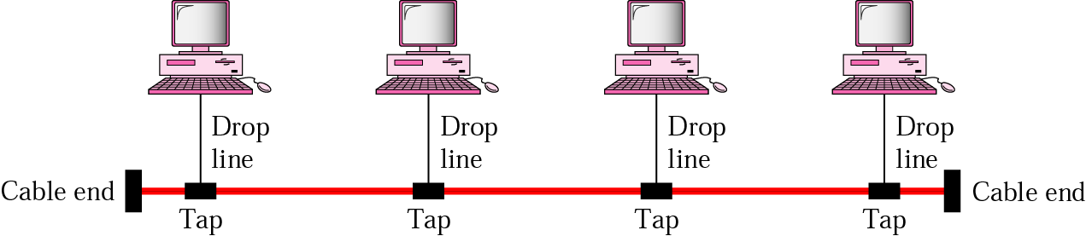
Contd…
Bus topology: Also known as backbone network topology, this configuration connects all devices to a main cable via drop lines. The advantages of bus network topology lie in its simplicity, as there is less cable required than in alternative topologies, which makes for easy installation.

Slide 9
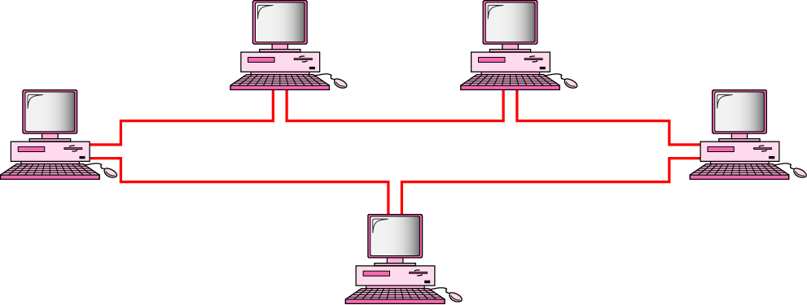
Contd…
Ring topology: Two dedicated point-to-point links connect a device to the two devices located on either side of it, creating a ring of devices through which data is forwarded via repeaters until it reaches the target device.

Slide 10
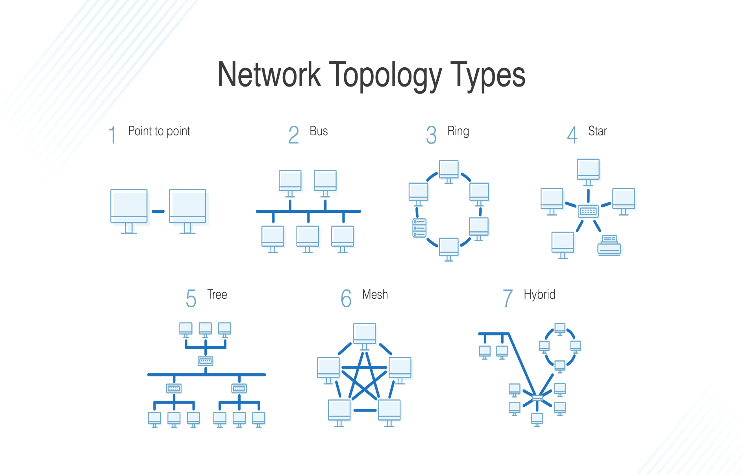
Contd…

Slide 11
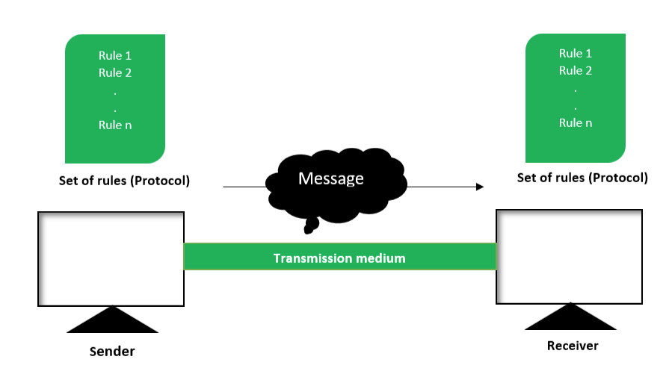
Components of Communication
Data communication is the exchange of data between two devices via a transmission medium.

Slide 12
Components of Communication
There are mainly five components of a data communication system:
1. Message: This is most useful asset of a data communication system. The message simply refers to data or piece of information which is to be communicated. A message could be in any form, it may be in form of a text file, an audio file, a video file, etc.

Slide 13
Contd…
2. Sender: To transfer message from source to destination, someone must be there who will play role of a source. Sender plays part of a source in data communication system. It is simple a device that sends data message. The device could be in form of a computer, mobile, telephone, laptop, video camera, or a workstation, etc.

Slide 14
Contd…
3. Receiver: It is destination where finally message sent by source has arrived. It is a device that receives message. Same as sender, receiver can also be in form of a computer, telephone mobile, workstation, etc. 4. Transmission medium: In entire process of data communication, there must be something which could act as a bridge between sender and receiver, Transmission medium plays that parts.

Slide 15
Contd…
It is physical path by which data or message travels from sender to receiver. Transmission medium could be guided (with wires) or unguided (without wires), for example, twisted pair cable, fiber optic cable, radio waves, microwaves, etc.
5. Set of rules: the protocol is a set of rules that govern data communication. If two different devices are connected but there is no protocol among them, there would not be any kind of

Slide 16
Contd…
communication between those two devices. Thus the protocol is necessary for data communication to take place.

Slide 17
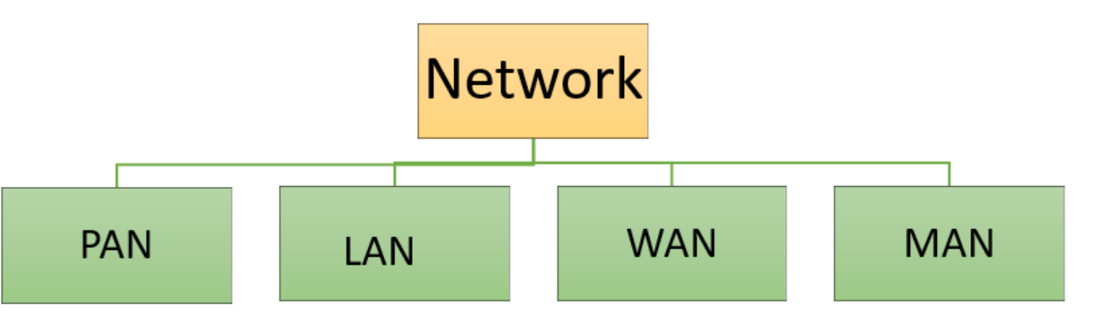
Types of Computer Networks:

Slide 18
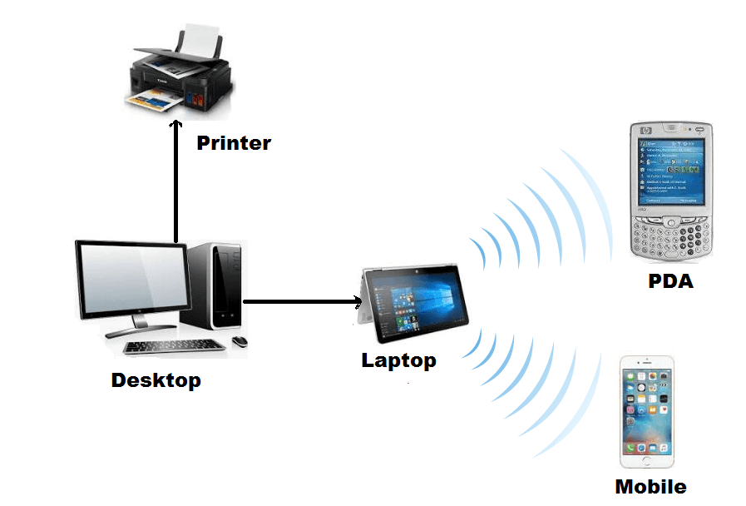
Types of Computer Networks:
PAN (Personal Area Network) is a computer network formed around a person. It generally consists of a computer, mobile, or personal digital assistant. PAN can be used for establishing communication among these personal devices for connecting to a digital network and the internet.
PAN networks are relatively secure and safe
It offers only short-range solution up to ten meters
Strictly restricted to a small area

Slide 19
Types of Computer Networks:
2. A Local Area Network (LAN) is a group of computer and peripheral devices which are connected in a limited area such as school, laboratory, home, and office building. It is a widely useful network for sharing resources like files, printers, games, and other application. The simplest type of LAN network is to connect computers and a printer in someone’s home or office. In general, LAN will be used as one type of transmission medium. It is a network which consists of less than 5000 interconnected devices across several buildings.
It is a private network, so an outside regulatory body never controls it.
LAN operates at a relatively higher speed compared to other WAN systems.
There are various kinds of media access control methods like token ring and ethernet.

Slide 20
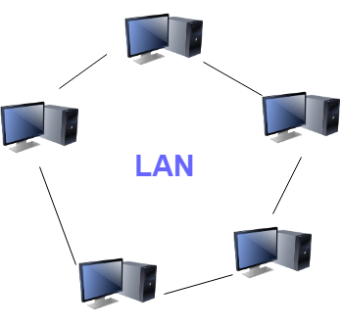

Slide 21
Types of Computer Networks:
3. A Metropolitan Area Network or MAN is consisting of a computer network across an entire city, college campus, or a small region. This type of network is large than a LAN, which is mostly limited to a single building or site. Depending upon the type of configuration, this type of network allows you to cover an area from several miles to tens of miles.
It mostly covers towns and cities in a maximum 50 km range
Mostly used medium is optical fibers, cables
Data rates adequate for distributed computing applications.

Slide 22
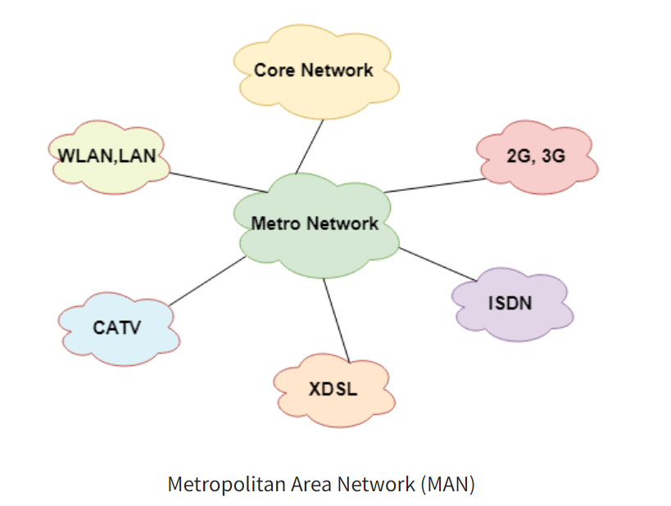

Slide 23
Types of Computer Networks:
4. WAN (Wide Area Network) is another important computer network that which is spread across a large geographical area. WAN network system could be a connection of a LAN which connects with other LAN’s using telephone lines and radio waves. It is mostly limited to an enterprise or an organization.
WAN helps you to cover a larger geographical area. Therefore business offices situated at longer distances can easily communicate.
Contains devices like mobile phones, laptop, tablet, computers, gaming consoles, etc.
WLAN connections work using radio transmitters and receivers built into client devices.

Slide 24
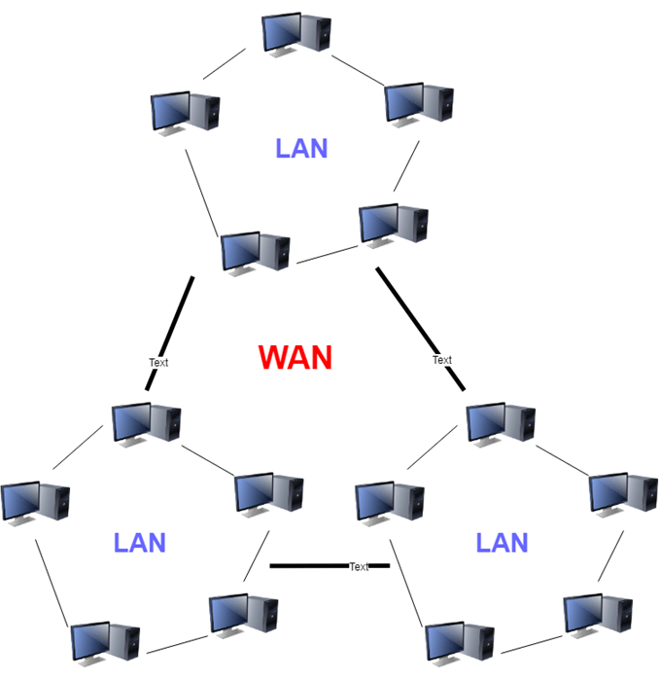

Slide 25
Modes of transfer
Transmission mode means transferring data between two devices. It is also known as a communication mode. Buses and networks are designed to allow communication to occur between individual devices that are interconnected. There are three types of transmission mode:-

Slide 26
Contd…
1. Simplex mode: the communication is unidirectional, as on a one-way street. Only one of the two devices on a link can transmit, the other can only receive. The simplex mode can use the entire capacity of the channel to send data in one direction.

Slide 27
Contd…
2. Half-Duplex mode: In half-duplex mode, each station can both transmit and receive, but not at the same time. When one device is sending, the other can only receive, and vice versa. The half-duplex mode is used in cases where there is no need for communication in both directions at the same time. The entire capacity of the channel can be utilized for each direction.

Slide 28
Contd…
3. Full-duplex: In full-duplex mode, both stations can transmit and receive simultaneously. In full_duplex mode, signals going in one direction share the capacity of the link with signals going in another direction, this sharing can occur in two ways:
Either the link must contain two physically separate transmission paths, one for sending and the other for receiving. Or the capacity is divided between signals travelling in both directions. Full-duplex mode is used when communication in both directions is required all the time.

Slide 29
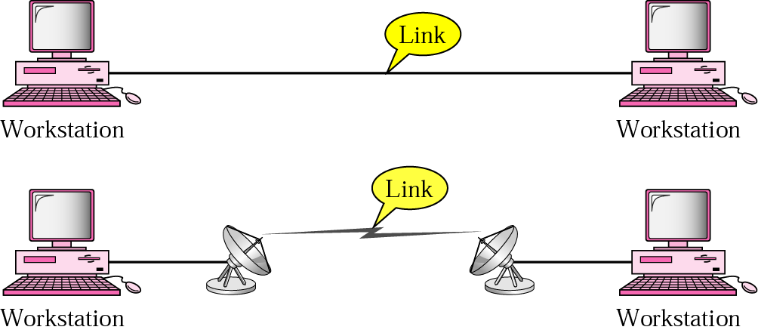
Types of connections
The following are the three basic types of network connection:
Point-to-point: Point-to-point connections allow one device to communicate with one other device. For example, two phones may pair with each other to exchange contact information or pictures.

Slide 30
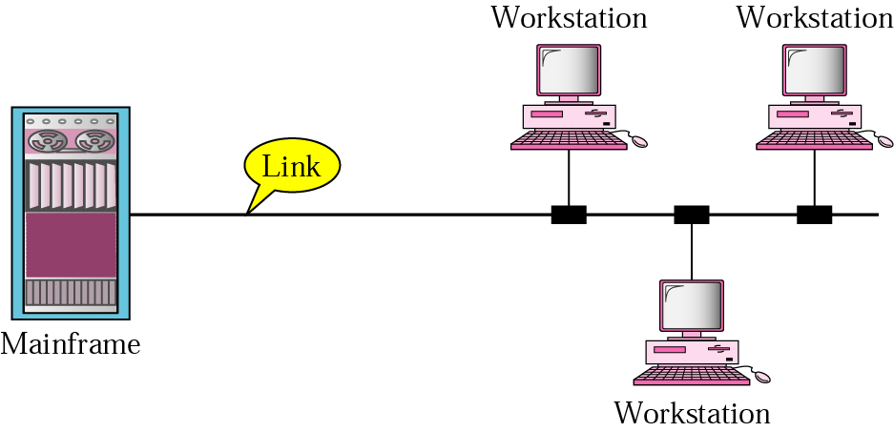
Contd…
Broadcast: Broadcast/multicast connections allow a device to send one message out to the network and have copies of that message delivered to multiple recipients.
Multi-point: It allow one device to connect and deliver messages to multiple devices in parallel.

Slide 31
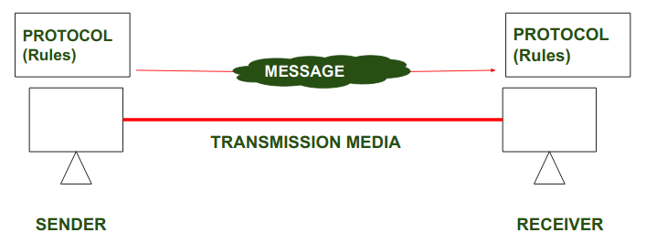
Network software
Protocols: A protocol is a set of rules that governs data communication; the key elements of a protocol are
1. Syntax – data formats and Signal levels
2. Semantics – control information and error handling
3. Timing – speed matching and sequencing

Slide 32
Contd…
Standards: Standards are the set of rules for data communication that are needed for exchange of information among devices. It is important to follow Standards which are created by various Standard Organization like IEEE, ISO, ANSI etc.
Types of standards:
De Facto standard: The meaning of the work ”De Facto” is ”By Fact” or “By Convention”. These are the standards that have not been approved by any organization, but have been adopted as Standards because of it’s widespread use.

Slide 33
Contd…
2. De Jure standard: The meaning of the word “De Jure” is “By Law” or “By Regulations”. Thus , these are the standards that have been approved by officially recognized body like ANSI , ISO , IEEE etc. These are the standard which are important to follow if it is required or needed.

Slide 34
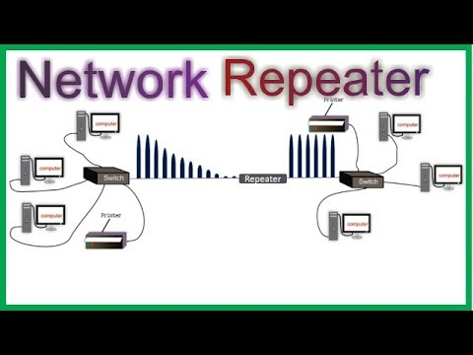
Network devices
Repeater: A repeater operates at the physical layer. Its job is to regenerate the signal over the same network before the signal becomes too weak or corrupted so as to extend the length to which the signal can be transmitted over the same network.

Slide 35
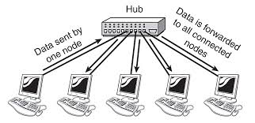
Network devices
Hub: A hub is basically a multiport repeater. A hub connects multiple wires coming from different branches, for example, the connector in star topology which connects different stations. Hubs cannot filter data, so data packets are sent to all connected devices.

Slide 36
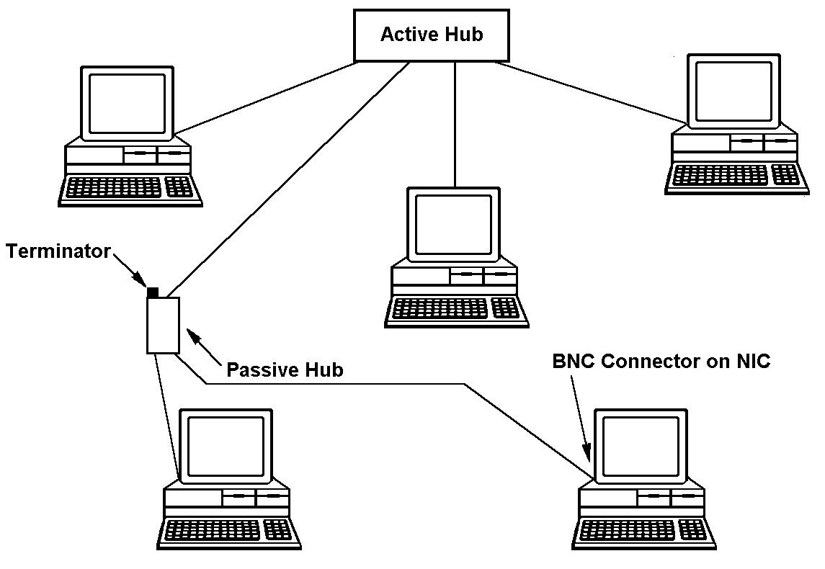
Contd…
Types of hub:
Active hub: These are the hubs that have their own power supply and can clean, boost, and relay the signal along with the network. It serves both as a repeater as well as a wiring center. These are used to extend the maximum distance between nodes.
Passive hub: These are the hubs that collect wiring from nodes and power supply from the active hub. These hubs relay signals onto the network without cleaning and boosting them and can’t be used to extend the distance between nodes.

Slide 37
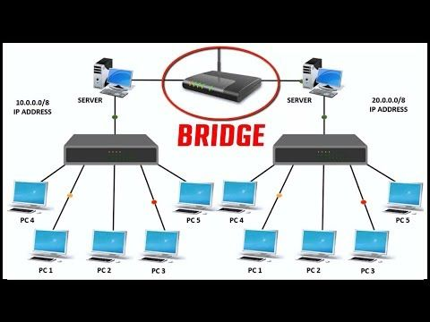
Contd…
Bridge: A bridge operates at the data link layer. A bridge is a repeater, with add on the functionality of filtering content by reading the MAC addresses of source and destination. It is also used for interconnecting two LANs working on the same protocol. It has a single input and single output port, thus making it a 2 port device.

Slide 38
Contd…
Types of Bridges:
Transparent bridge: These are the bridge in which the stations are completely unaware of the bridge’s existence i.e. whether or not a bridge is added or deleted from the network, reconfiguration of the stations is unnecessary.
Source routing bridge: In these bridges, routing operation is performed by the source station and the frame specifies which route to follow. The host can discover the frame by sending a special frame called the discovery frame, which spreads through the entire network using all possible paths to the destination.

Slide 39
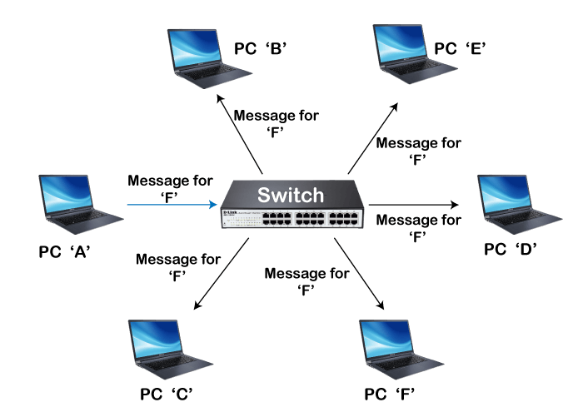
Contd…
Switch: A switch is a multiport bridge with a buffer and a design that can boost its efficiency (a large number of ports imply less traffic) and performance. A switch is a data link layer device. The switch can perform error checking before forwarding data, which makes it very efficient as it does not forward packets that have errors and forward good packets selectively to the correct port only.

Slide 40
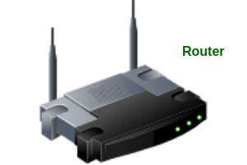
Contd…
Routers: A router is a device like a switch that routes data packets based on their IP addresses. The router is mainly a Network Layer device. Routers normally connect LANs and WANs together and have a dynamically updating routing table based on which they make decisions on routing the data packets.

Slide 41
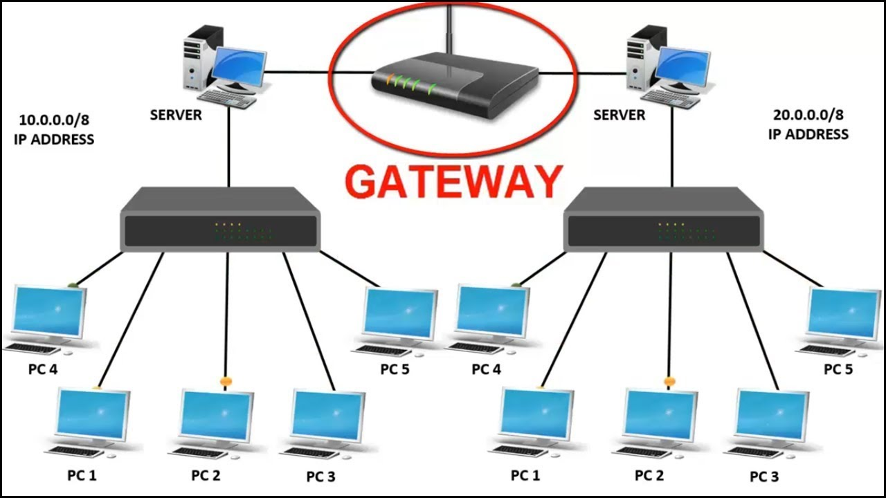
Contd…
Gateway: A gateway, as the name suggests, is a passage to connect two networks together that may work upon different networking models. They basically work as the messenger agents that take data from one system, interpret it, and transfer it to another system. Gateways are also called protocol converters and can operate at any network layer. Gateways are generally more complex than switches or routers. Gateway is also called a protocol converter.

Slide 42
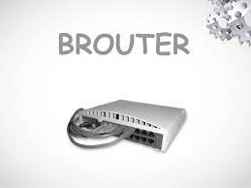
Contd…
Brouter: It is also known as the bridging router is a device that combines features of both bridge and router. It can work either at the data link layer or a network layer.

Slide 43
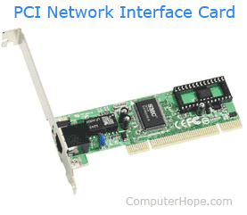
Contd…
NIC: NIC or network interface card is a network adapter that is used to connect the computer to the network. It is installed in the computer to establish a LAN. It has a unique id that is written on the chip, and it has a connector to connect the cable to it. The cable acts as an interface between the computer and router or modem. NIC card is a layer 2 device which means that it works on both physical and data link layer of the network model.

Slide 44
Introduction of cables
Networking cables are a type of networking hardware used to connect a network device to one or more other network devices, or to connect two or more devices to a single computer or network device.
Network cables act as a medium through which information and data travel from one network device to another. The type of cable used for a network depends on the network’s topology, size, and procedure. The different types of network cables act as the supporting basis of the network infrastructure.

Slide 45
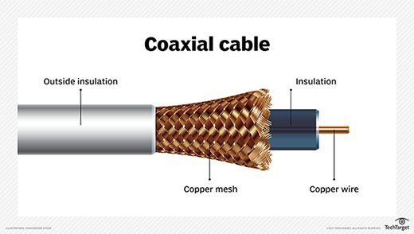
Contd…
There are four types of networking cables:
Coaxial cables: Coaxial cables have a single copper conductor at the center, while a plastic layer provides insulation between the center conductor and braided metal shield. The metal shield blocks outside interference from fluorescent lights, motors, and other computers.

Slide 46
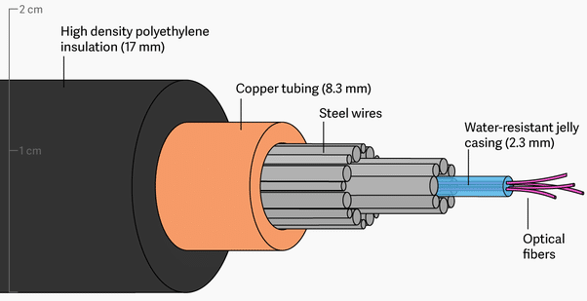
Contd…
Fiber optic cable: Fiber optic cables possess a center glass core surrounded by multiple layers of protective materials. They avoid electrical obstruction by transmitting light instead of electronic signals, making them perfect for environments with large amounts of electrical interference.

Slide 47
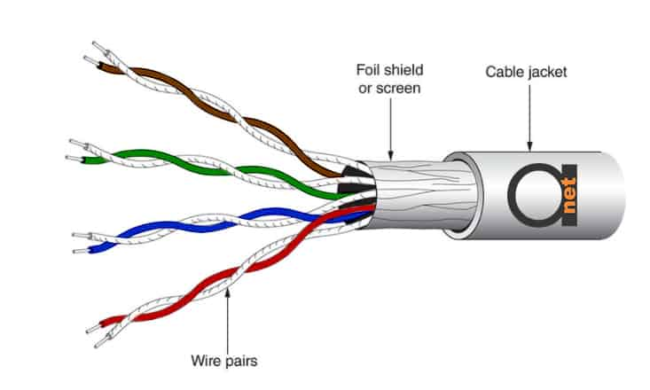
Contd…
Shielded Twisted pair (STP) cable: Shielded twisted pair cables can be perfect if you want to set up cables in an area with potential interference and risks to an unshielded twisted pair cable’s electrical current. Shielded twisted pair cables can also help to expand the distance between the cables.

Slide 48
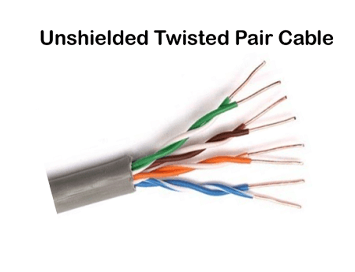
Contd…
Unshielded Twisted pair (UTP) cable: Unshielded twisted pair (UTP) cables are broadly used in the telecommunications and computer industries as ethernet cables and telephone wires. In a UTP cable, conductors forming a single circuit are twisted around one another to cancel out electromagnetic interference (EMI) from external sources.

